Slide 1

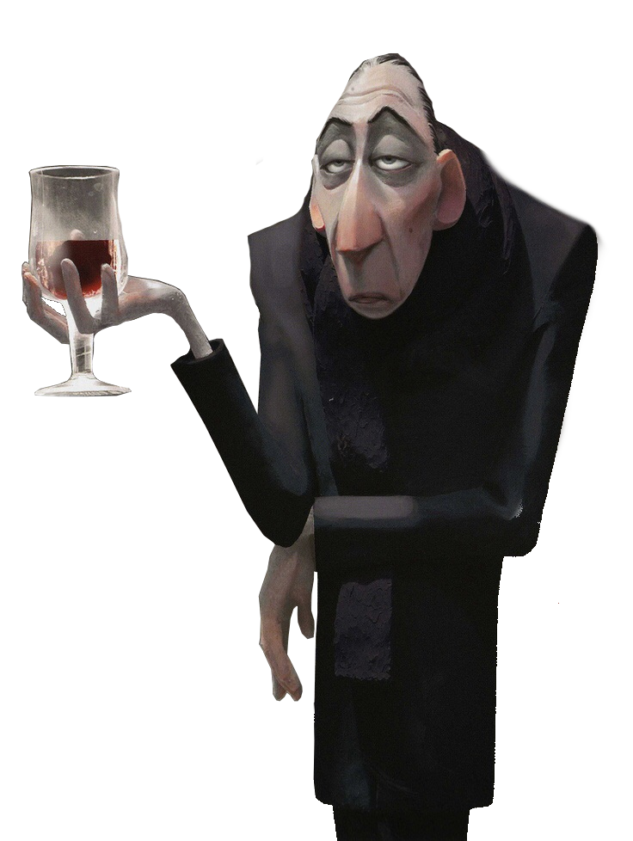
The one pp to rule them all
By Antong Gabo

Slide 2
Ranking criterias
Quality of the PP
Size of the PP
Presentation of the PP
Final vote: X+Y+Z / 2

Slide 3
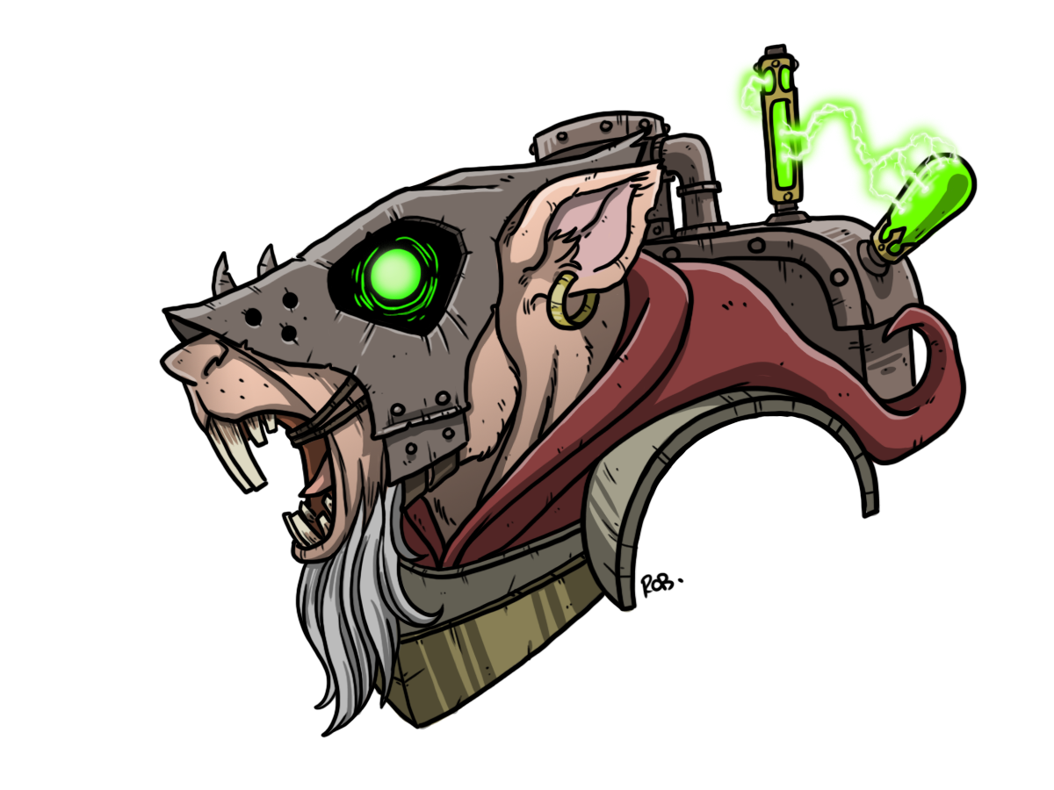
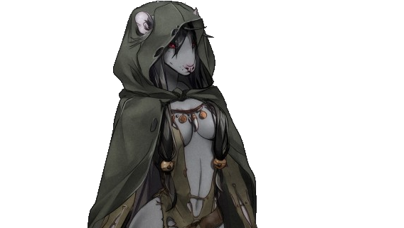
Slowpoke and the Skaven 🐀
Quality: 7.5/10 Size: 8/10 Presentation: 8/10
Ideal Poke Skaven Gf - Sexualised beyond belief - Doesn’t carry the pox - Isn’t insane enough to eat Polonium
Actual Skaven Gf
Can’t tell if its a woman
Life expectancy of 11 days
Eats Pollonium

Slide 4
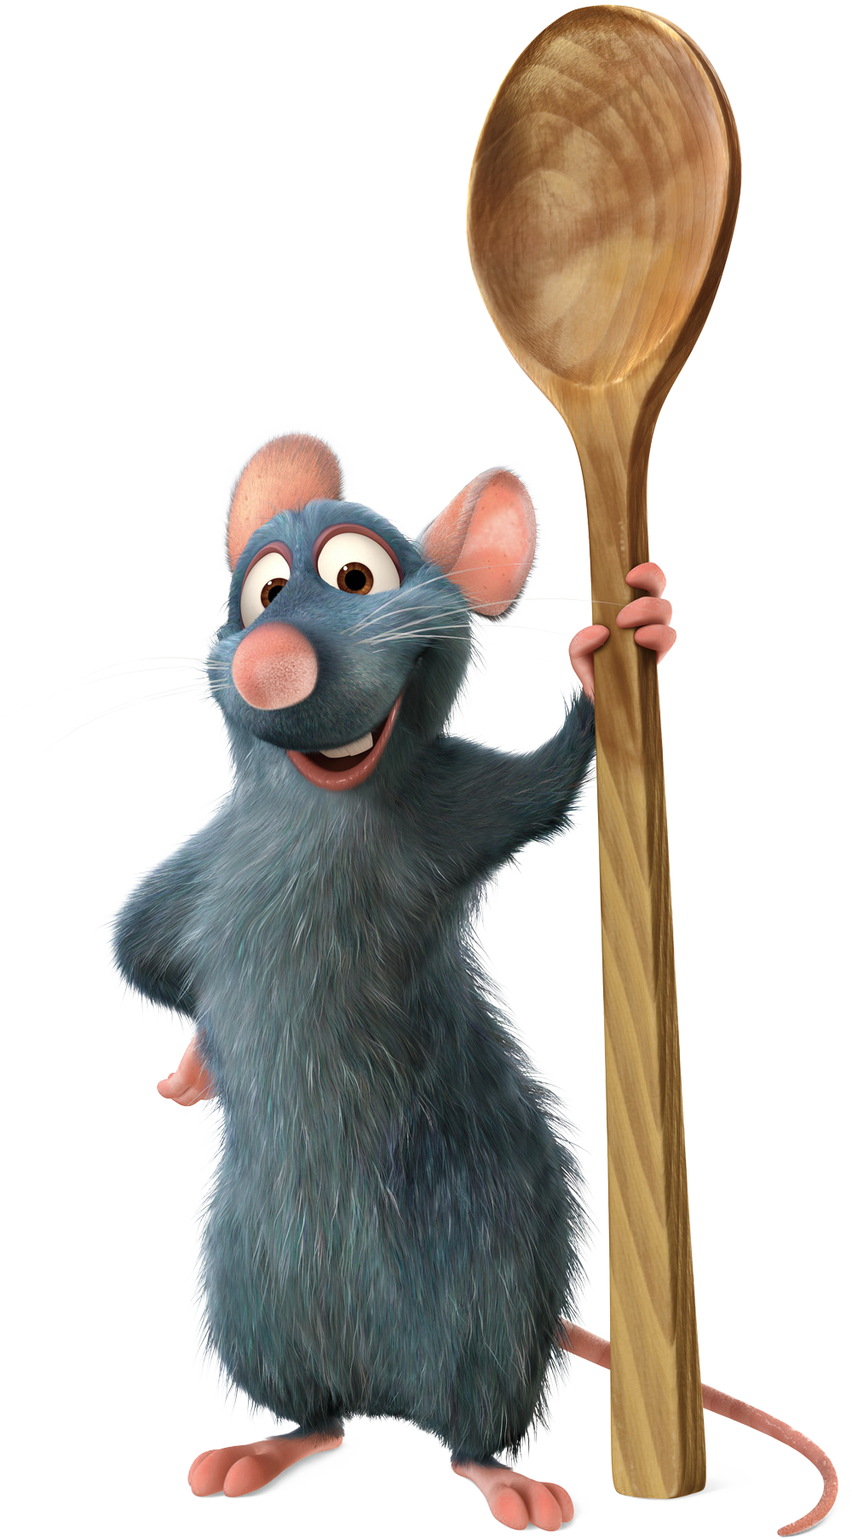
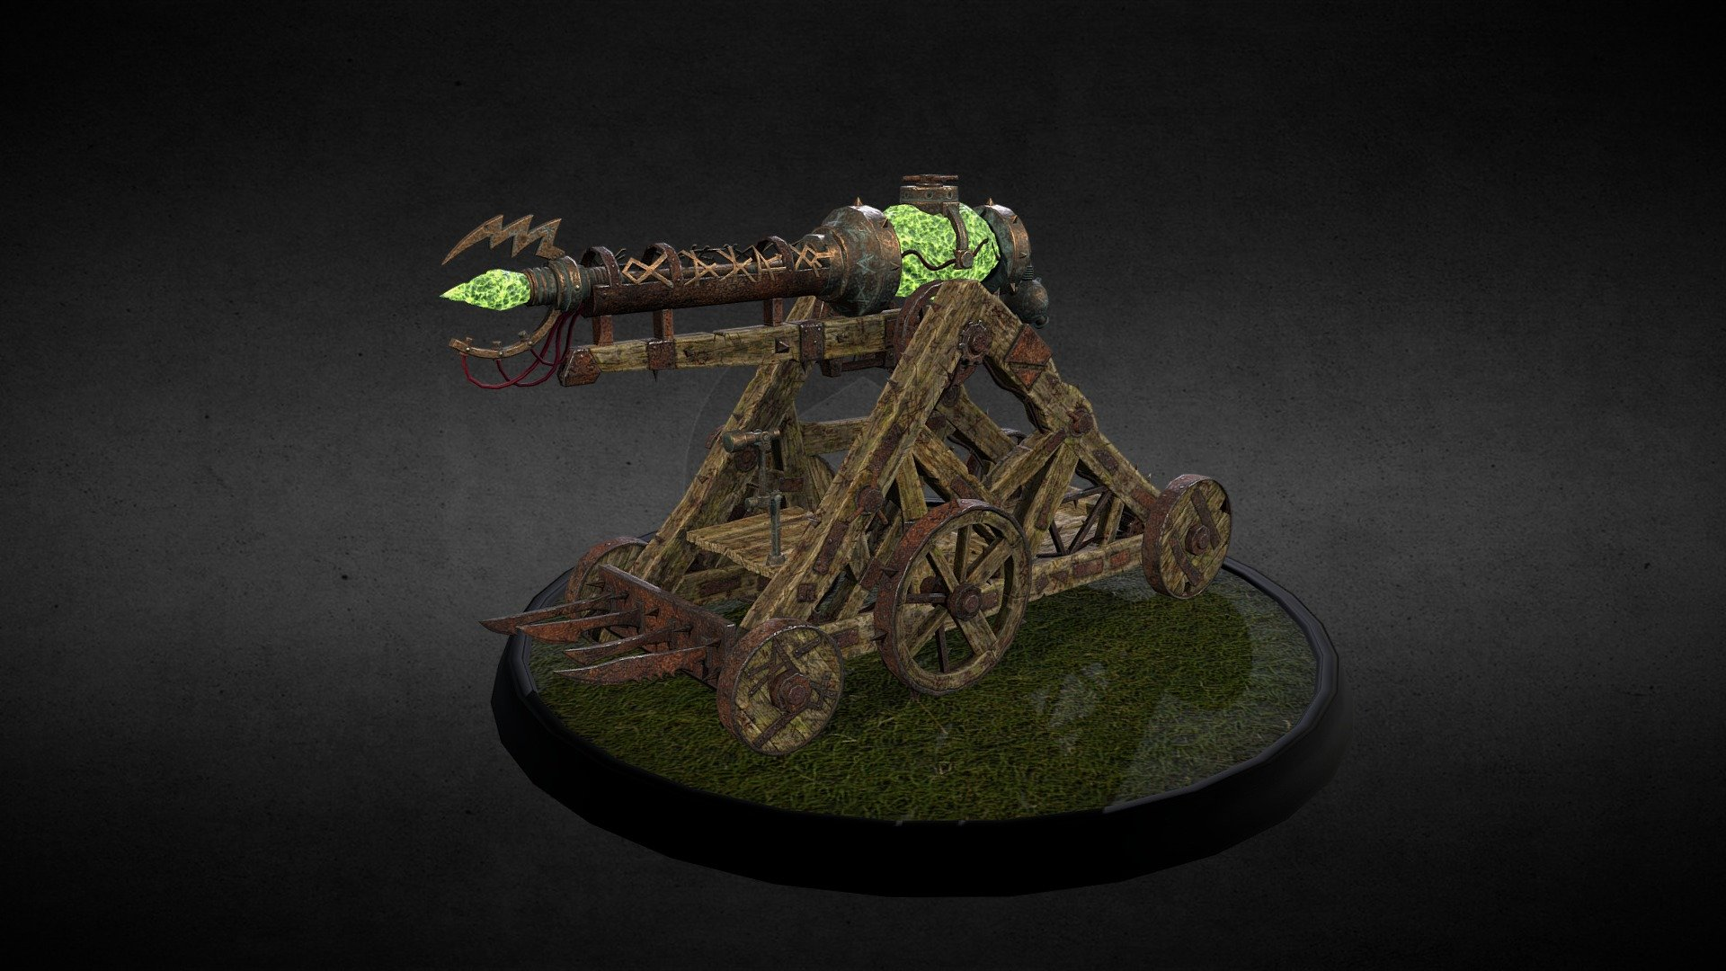
Final Vote
6 Rattatouilles and a siege warpcannon

Slide 5

Farris and the Green Seer 👹
Quality: 9/10 Size: 7.5/10 Presentation: 8/10

Slide 6
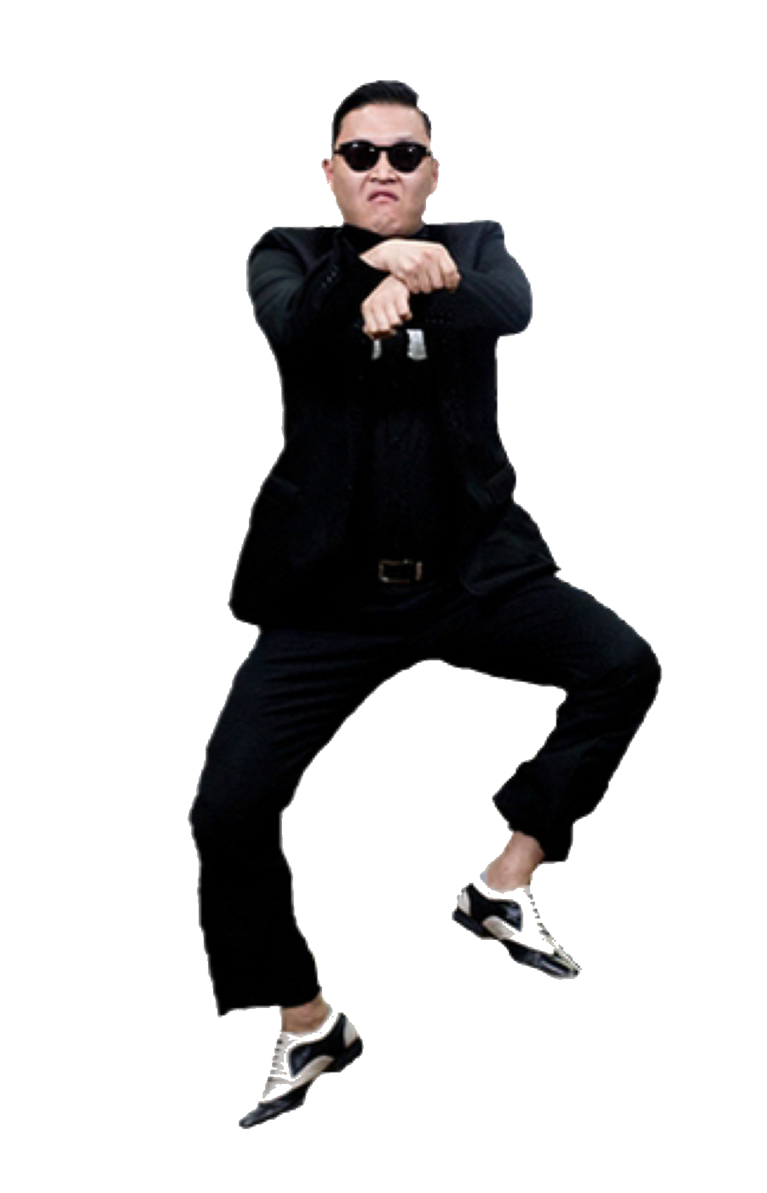
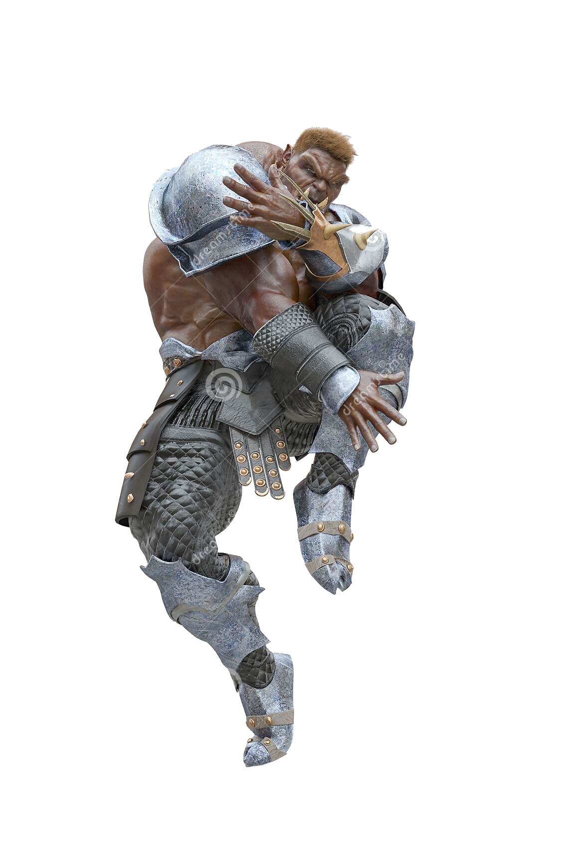
Final Vote
An army of okrs jamming at Gangam Style

Slide 7


Carmen and the Bunies 🐰
Quality: 10/10 Size: 6.5/10 Presentation: 7.5/10

Slide 8
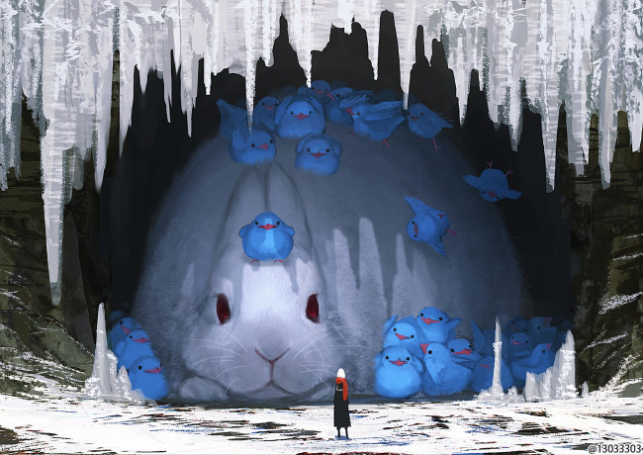
Final Vote
An enormous bunny

Slide 9
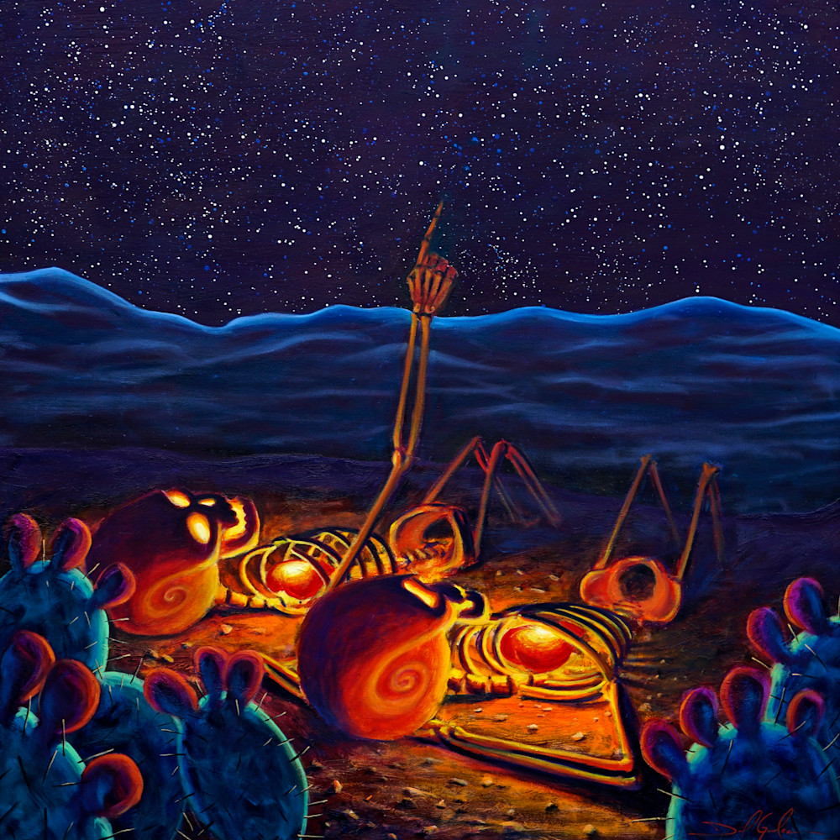
Amber and lots of Death 💀
Quality: 💀/10 Size: Unexpected/10 Presentation: 9/10
POV:
YOU ARE
YOU ARE A STARGAZER

Slide 10
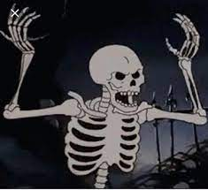
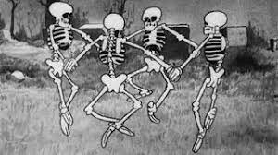
Final Vote
Spooky Scary Skeletons (Only on alternating saturdays(Unlucky, it’s an alternating Saturday))
And jarlaxle

Slide 11

Lupus and his Backup 🎎
Quality: 8.5/10 Size: 6/10 Presentation: 10/10
Lupus lore:

Slide 12
Final Vote
l lI ll l—
(It’s loss)

Slide 13
Judge and Frostpunk 🧊
Quality: 10/10 Size: 8/10 Presentation: 6/10

Slide 14


Final Vote
A dozen fresh coal deposits, and an army of children to put to work at the food huts.

Slide 15
So… who IS the winner…?
……….

Slide 16

Everyone!!!

